Slide 1
Lecture Notes for Chapter 9:
Medians and Order Statistics
Sun-Yuan Hsieh
謝孫源 教授
成功大學資訊工程學系

Slide 2


Chapter 9 overview
ith order statistic is the ith smallest element of a set of n elements
The minimum is the first order statistic (i = 1).
The maximum is the nth order statistic (i = n).
A median is the “halfway point” of the set.
When n is odd, the median is unique, at i = ( n + 1 ) / 2.
When n is even, there are two medians:
  The lower median, at i = n / 2, and
  The upper median, at i = n / 2 + 1.
  We mean lower median when we use the phrase “the median.”

Slide 3
The selection problem
Input: A set A of n distinct numbers and a number i, with
1 ≤ i ≤ n.
Output: The element x ∈ A that is larger than exactly i – 1
other elements in A. In other words, the ith smallest
element of A.
The selection problem can be solved in O (nlgn) time.
Sort the numbers using an O (nlgn)-time algorithm, such as heap sort or merge sort.
Then return the ith element in the sorted array.

Slide 4
Minimum and Maximum
We can easily obtain an upper bound of n – 1 comparisons
for finding the minimum of a set of n elements.
Examine each element in turn and keep track of the smallest one.
This is the best we can do, because each element, except the minimum, must be compared to a smaller element at least once.

Slide 5
Minimum and Maximum
The following pseudocode finds the minimum element in
array A[1…n]:
MINIMUM (A, n)
min ← A[1]
for i ← 2 to n
do if min > A[ i]
then min ← A[ i]
return min
The maximum can be found in exactly the same way by
replacing the > with < in the above algorithm.

Slide 6
Simultaneous minimum and maximum
A simple algorithm to find the minimum and maximum: n – 1 comparisons for the minimum and n – 1 comparisons for maximum ⇒ total 2n – 2 comparisons ⇒ Θ(n) time.
In fact, at most 3 ⎣n / 2⎦ comparisons are needed to find both the minimum and maximum !

Slide 7
Simultaneous minimum and maximum (cont.)
Compare the elements of a pair to each other.
Then compare the larger element to the maximum so far, and compare the smaller element to the minimum so far.
This leads to only 3 comparisons for every 2 elements.
Setting up the initial values for the min and max depends on whether
n is odd or even.
If n is even, compare the first two elements and assign the larger to max and the smaller to min. Then process the rest of the elements in pairs.
If n is odd, set both min and max to the first element. Then process the rest of the elements in pairs.

Slide 8
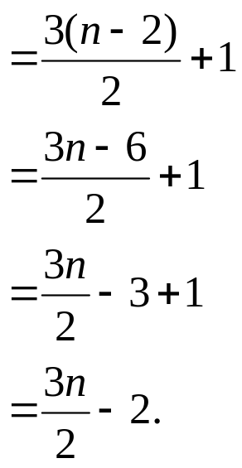
Analysis of the total number of comparisons
If n is even, we do 1 initial comparison and then 3(n – 2) / 2 more comparisons.
# of comparisons
If n is odd, we do 3(n – 1) / 2 = 3 ⎣ n /2 ⎦ comparisons.
In either case, the maximum number of comparisons is ≤ 3 ⎣ n / 2 ⎦ .

Slide 9
Selection in expected linear time
RANDOMIZED-SELECT( A, p, r, i)
if p = r
then return A[ p]
q ← RANDOMIZED-PARTITION ( A, p, r )
k ← q – p + 1
if i = k ► pivot value is answer
then return A[ q]
elseif i < k
then return RANDOMIZED-SELECT( A, p, q – 1, i )
else return RANDOMIZED-SELECT( A, q + 1, r, i – k )

Slide 10
Selection in expected linear time
After the call to RANDOMIZED-PARTITON, the array is partitioned into two
subarrays A[ p …q – 1 ] and A[ q + 1 …r], along with a pivot element A[ q ].
The elements of subarray A[ p …q – 1 ] are all ≤ A[ q ].
The elements of subarray A[ q + 1 …r] are all > A[ q ].
The pivot elemen is kth element of subarray A[ p …q], where k = q – p + 1.
If the pivot element is the ith smallest element (i.e., i = k), return A[ q ].
Otherwise, recurse on the subarray containing the ith smallest element.
  If i < k, this subarray is A[ p …q – 1 ], and we want the ith smallest element.
  If i > k, this subarray is A[ q + 1 …r ] and, since there are k elements in A[ p … r] that precede A[ q + 1 …r ], we want the (i – k)th smallest element of this subarray.

Slide 11
Analysis
Worst-case running time: Θ(n²), because we could be
extremely unlucky and always recurse on a subarray that is
only 1 element smaller than the previous subarray.
Expected running time: RANDOMIZED-SELECT works
well on average.

Slide 12
Analysis
The running time of RANDOMIZED-SELECT is a random
variable T(n) ⇒ to obtain E[T(n)] as follows:
For k = 1, 2, …, n, define indicator random variable
X_{k} = I {subarray A[ p … q] has exactly k elements}.
Since Pr {subarray A[ p … q] has exactly k elements} = 1/n, Lemma 5.1 says that E[ X_{k} ] = 1/n.

Slide 13
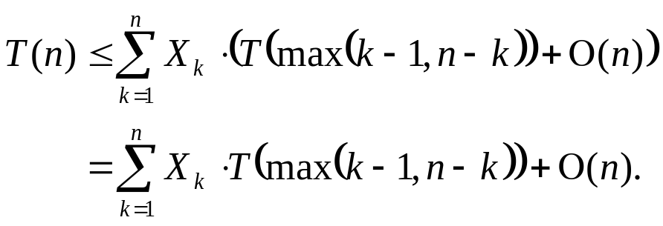
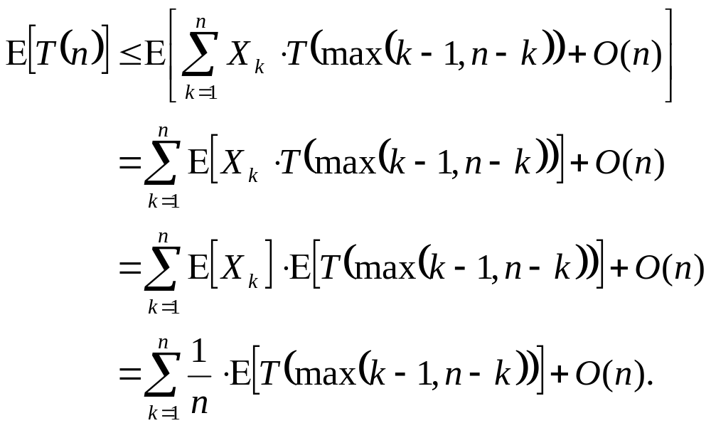
Analysis
Therefore, we have the recurrence
Taking expected values gives
(linearity of expectation)
(equation (C.23))

Slide 14
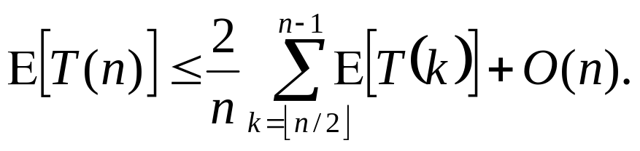
Analysis
We rely on X_{k} and T (max( k – 1, n – k)) being independent random variables in order to apply equation (C.23).
Looking at the expression max( k – 1, n – k), we have
  If n is even, each term from T ( ⎡ n / 2⎤ ) up to T ( n – 1) appears exactly twice in the summation.
  If n is odd, these terms appear twice and T ( ⎣ n / 2⎦ ) appears once.
Either way,

Slide 15
Analysis
Solve this recurrence by substitution:
  Guess that T ( n) ≤ cn for some constant c that satisfies the initial conditions of the recurrence
  Assume that T ( n) = O(1) for n < some constant
  Also pick a constant a such that the function described by the O(n) term is bounded from above by an for all n > 0

Slide 16
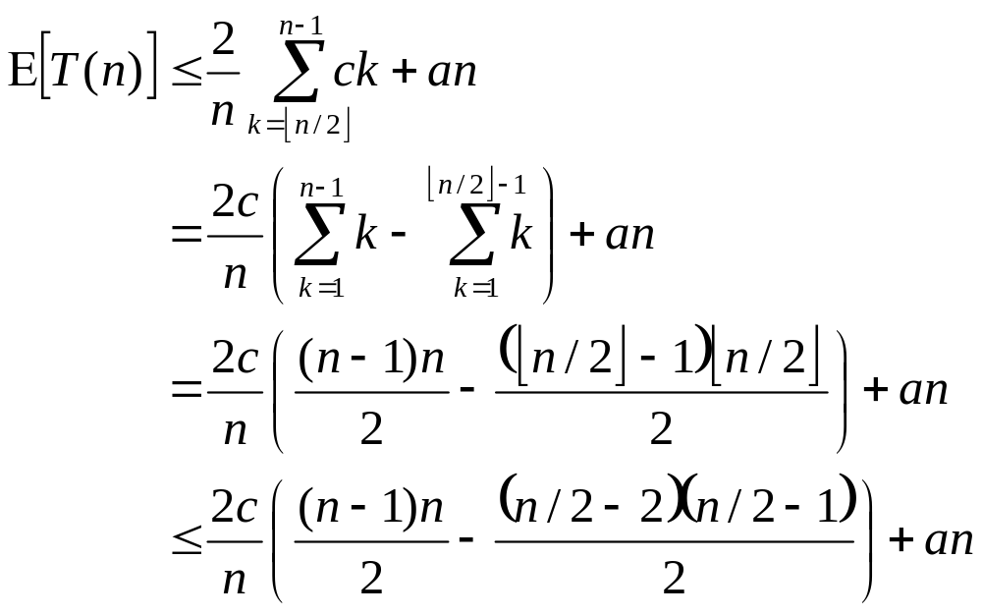
Analysis

Slide 17
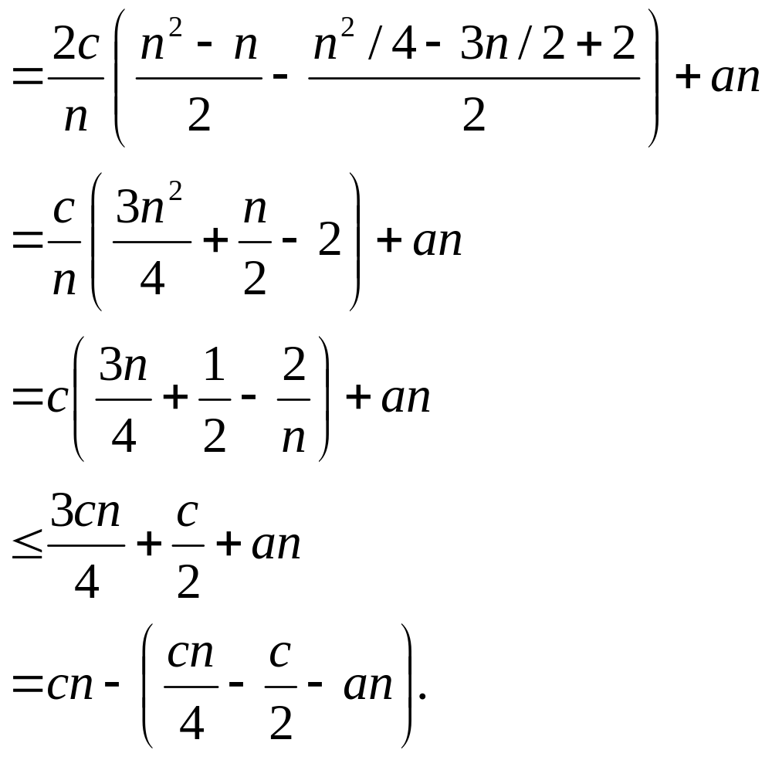
Analysis

Slide 18
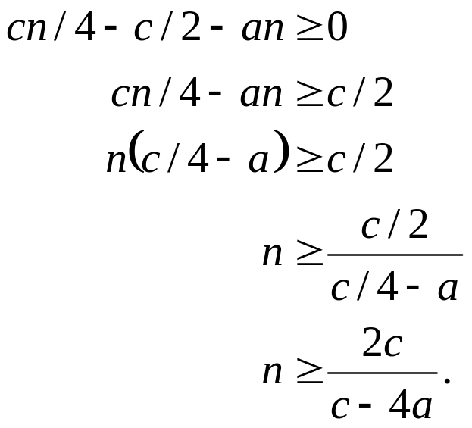
Analysis
  To complete this proof, we choose c such that
  Thus, as long as we assume that T ( n ) = O( 1 ) for n < 2c / (c – 4a), we have E[T ( n )] = O( n ).
Therefore, we can determine any order statistic in linear time on average.

Slide 19
Selection in worst-case linear time
SELECT works on an array of n > 1 elements:
Divide the n elements into groups of 5. Get ⎡n / 5⎤ groups: ⎣n / 5⎦ groups with exactly 5 elements and, if 5 does not divide n, one group with the remaining n mod 5 elements.
Find the median of each of the ⎡n / 5⎤ groups:
  Run insertion sort on each group. Takes O( 1 ) time per group since each group has ≤ 5 elements.
  Then just pick the median from each group, in O( 1 ) time.
Find the median x of the ⎡n / 5⎤ medians by a recursive call to SELECT. (If ⎡n / 5⎤ is even, then follow our convention and find the lower median.)
Using the modified version of PARTITION that takes the pivot element as input, partition the input array around x. Let x be the kth element of the array after partitioning, so that there are k – 1 elements on the low side of the partition and n – k elements on the high side.

Slide 20
Selection in worst-case linear time
Now there are three possibilities:
  If i = k, just return x.
  If i < k, return the ith smallest element on the low side of the partition by making a recursive call to SELECT.
  If i > k, return the (i – k )th smallest element on the high side of the partition by making a recursive call to SELECT.

Slide 21
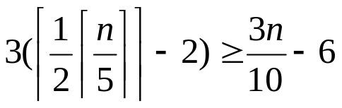
Analysis
Start by getting a lower bound on the number of elements that are
greater than the partitioning element x:
[Each group is a column. Each white circle is the median of a group, as found
in step 2. Arrows go from larger elements to smaller elements, based on what
we know after step 4. Elements in the region on the lower right are known to
be greater than x.]
x

Slide 22
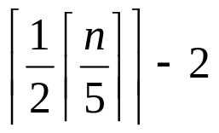
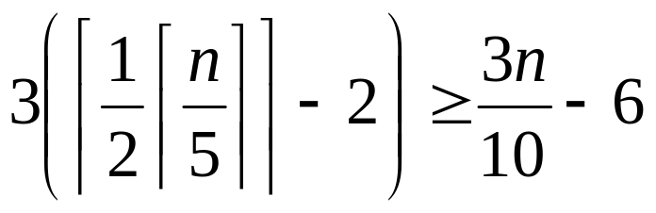
Analysis
At least half of the median found in step 2 are ≥ x.
Look at the groups containing these medians that are ≥ x. All of them contribute 3 elements that are > x (the median of the group and the 2 elements in the group greater than the group’s median), except for 2 of the groups: the group containing x (which has only 2 elements > x) and the group with < 5 elements.
Forget about these 2 groups. That leaves ≥ groups with 3elements known to be > x.
Thus, we know that at least
elements are > x.

Slide 23
Analysis
Symmetrically, the number of elements that are < x is ≥ 3n / 10 – 6.
Therefore, when we call SELECT recursively in step 5, it’s on ≤ 7n / 10 + 6
elements.
Develop a recurrence for the worst-case running time of SELECT:
Steps 1, 2, and 4 each take O ( n ) time:
  Step 1: making groups of 5 elements takes O ( n ) time.
  Step 2: sorting ⎡ n / 5 ⎤ groups in O ( 1 ) time each.
  Step 4: partitioning the n-element array around x takes O ( n ) time.
Step 3 takes time T ( ⎡ n / 5 ⎤ ).
Step 5 takes time ≤ T ( 7n / 10 + 6 ), assuming that T ( n ) is monotonically increasing.

Slide 24
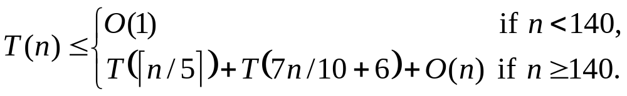
Analysis
Assume that T ( n ) = O ( 1 ) for small enough n. We’ll use n ≤ 140 as “small enough.”
Thus, we get the recurrence
Solve this recurrence by substitution:
Inductive hypothesis: T ( n ) ≤ cn for some constant c and all n > 0.
Assume that c is large enough that T ( n ) ≤ cn for all n ≤ 140. So we are concerned only with the case n ≤ 140.
Pick a constant a such that the function described by the O ( n ) term in the recurrence is ≤ an for all n > 0.

Slide 25
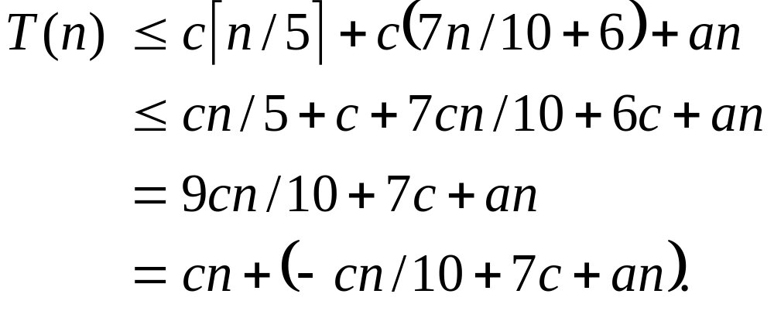
Analysis
Substitute the inductive hypothesis in the right-hand side of the recurrence:

Slide 26
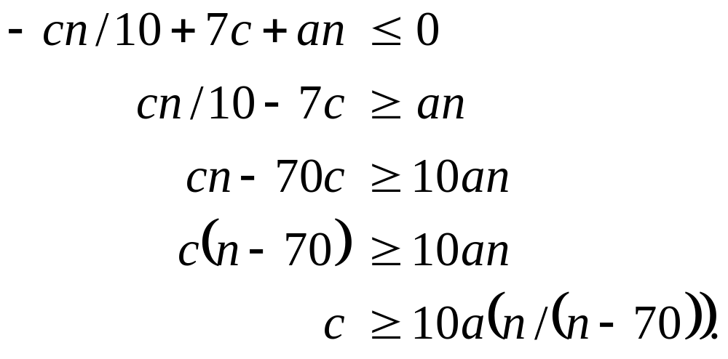
Analysis
This last quantity is ≤ cn if

Slide 27
Analysis
Because we assumed that n ≥ 140, we have n / ( n – 70 ) ≤ 2.
Thus, 20a ≥ 10a ( n / ( n – 70 ) ), so choosing c ≥ 20a gives c ≥ 10a (n / ( n – 70 ) ), which in turn gives us the condition we need to show that T ( n ) ≤ cn.
We conclude that T ( n ) = O ( n ), so that SELECT runs in linear time in all cases.

Slide 28
Analysis
Notice that SELECT and RANDOMIZED-SELECT
determine information about the relative order of elements
only by comparing elements.
Sorting requires Ω(nlgn) time in the comparison model.
Sorting algorithms that run in linear time need to make assumptions about their input.
Linear-time selection algorithms do not require any assumptions about their input.
Linear-time selection algorithms solve the selection problem without sorting and therefore are not subject to the Ω(nlgn) lower bound.

